Slide 1




Slide 2


State Management

Slide 3


About me
Sebbagh Djamel Eddine
Student at ESI in the 5th year
Ex Mobile Developer at The Agency
Freelancer
Contact: hd_sebbagh@esi.dz

Slide 4

Plan
Stateless vs Stateful
What is State
State Management Approaches
Provider

Slide 5
Stateless vs Stateful
Stateless widget never changes
Ex : Icon, Text, Container,…
Stateful widget is dynamic
Ex : CheckBox, TextField, Slider,…

Slide 6
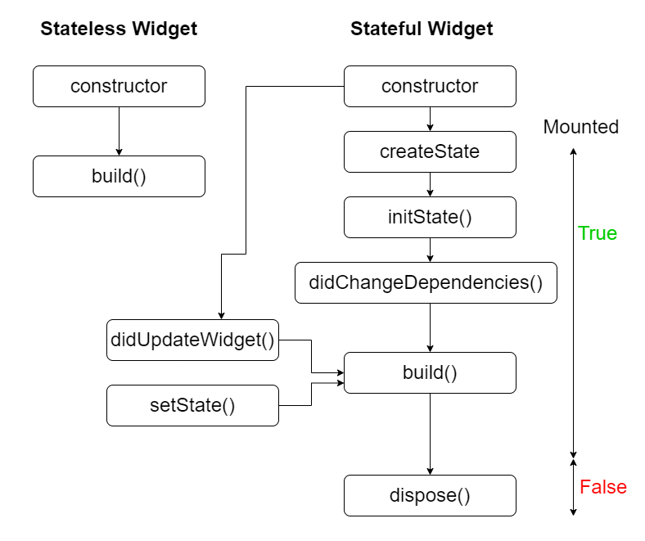
Stateless vs Stateful

Slide 7
State
State consists of values or any data stored in your app that can change
Like _counter in the default flutter app
State comes a time when you need to share application state between screens, across your app

Slide 8
State - Example

Slide 9
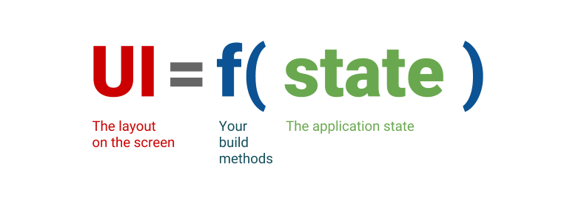
State – Declarative UI
Flutter is declarative. This means that Flutter builds its user interface to reflect the current state of your app.

Slide 10
Ephemeral state
Ephemeral state (sometimes called UI state or local state) is the state you can neatly contain in a single widget
Like : index of PageView, current Selected Tab in
a BottomNavigationBar.
There is no need to use state management techniques on this kind of state, All you need is StatefulWidget (setState is enough).

Slide 11
App state
State that is not ephemeral, that you want to share across many parts of your app, and that you want to keep between user sessions, is what we call application state (sometimes also called shared state).
Like : Login info, The shopping cart in an E-commerce app.
For managing app state, you’ll want to research your options. Your choice depends on the complexity and nature of your app, your team’s previous experience, and many other aspects.

Slide 12

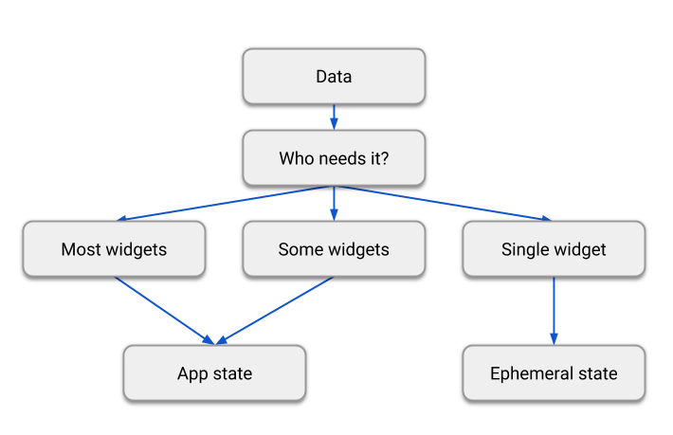
Ephemeral vs App state

Slide 13
Ephemeral vs App state
There is no clear-cut, universal rule to distinguish whether a particular variable is ephemeral or app state. Sometimes, you’ll have to refactor one into another. For example, you’ll start with some clearly ephemeral state, but as your application grows in features, it might need to be moved to app state.
“The rule of thumb is: Do whatever is less awkward.”

Slide 14
State Management Approaches
setState
InheritedWidget & InheritedModel
Provider
Riverpod
Redux
Bloc
Mobx, GetX,…..

Slide 15
Provider

Slide 16
Provider
ChangeNotifier
ChangeNotifierProvider
Consumer

Slide 17
Thanks

Slide 18


